Slide 1

Anti Theft Surveillance System
Students Names:
Muhammad Ahmad Falak
Ahmad Khan
Supervisor:
Prof.Thomas Scheffler

Slide 2

Anti Theft Surveillance System

Slide 3
Overview
Problem Statement/ What To Do
Aims and Objective
Why we Proposed this Technique?
Block Diagram
Working of Project
References

Slide 4


Problem Statement
Make People life Better

Slide 5

Aims and Objective
Alert Instantly
Prevention is better than cure

Slide 6
Proposed Methods/Techniques
Capture Motion
Send SmS
Send Email
Online Portal

Slide 7





Block Diagram
Motion Detected
key
Log into account

Slide 8
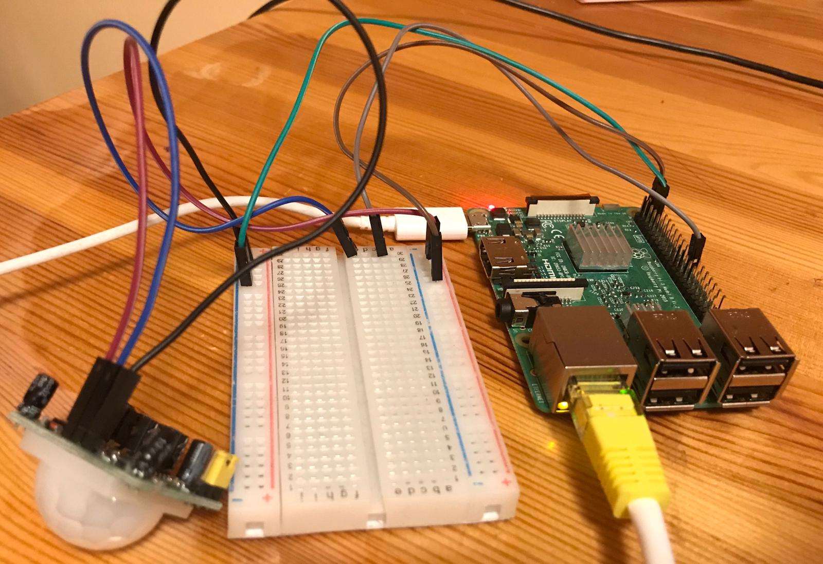
Workflow

Slide 9
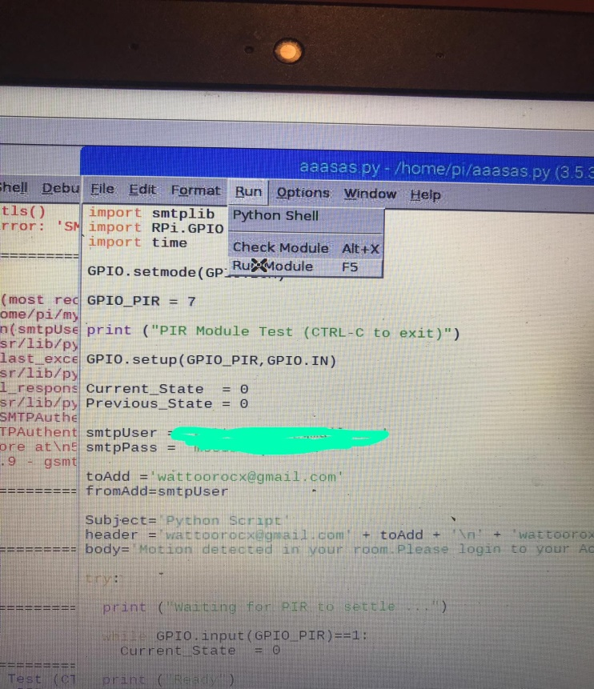
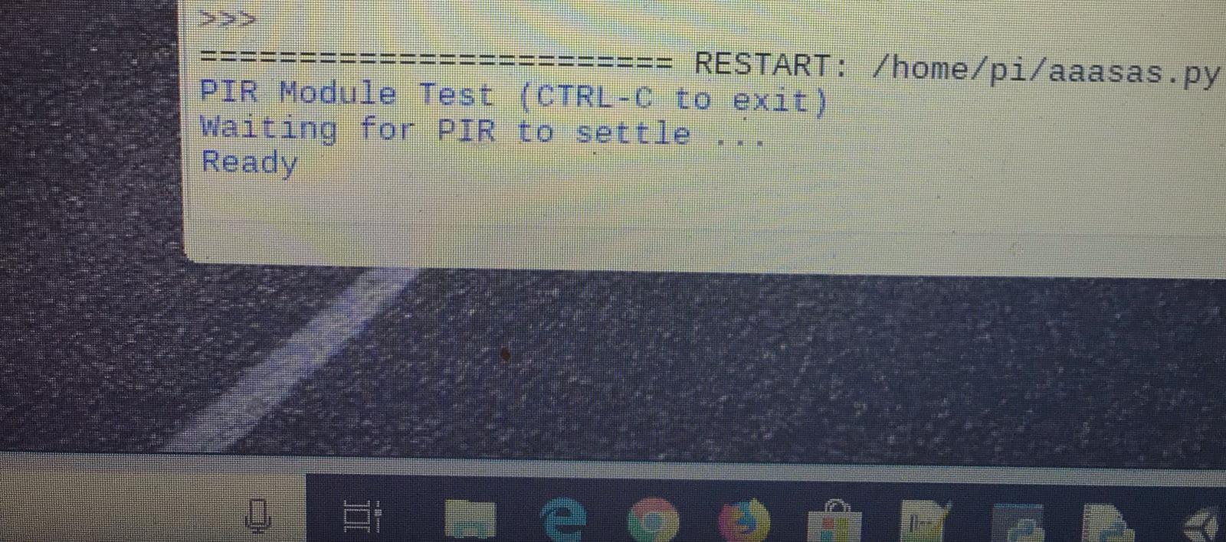
Workflow

Slide 10
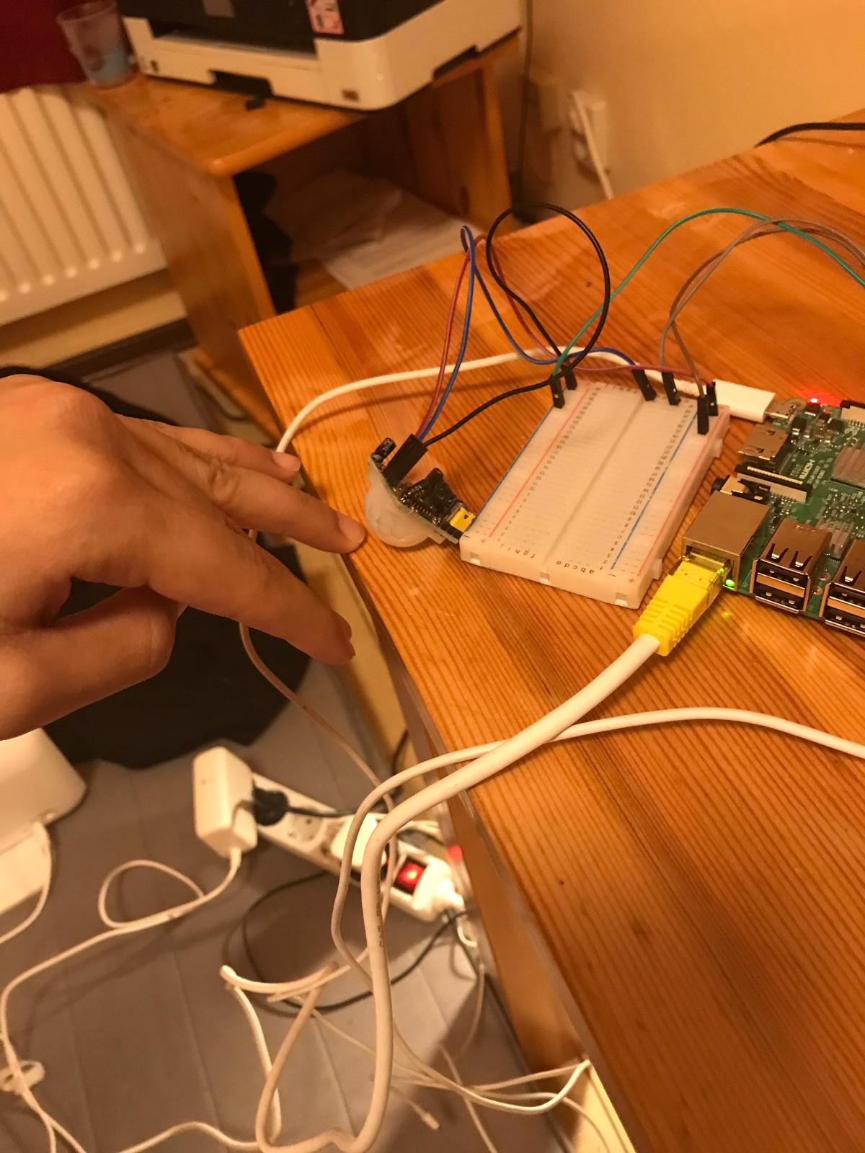
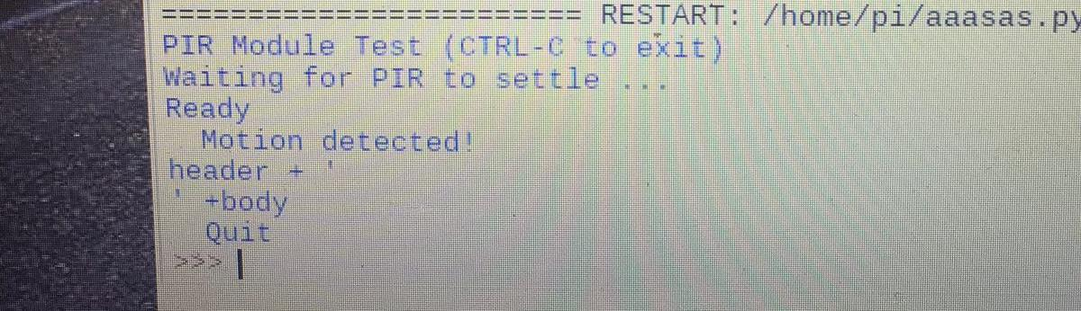
Workflow

Slide 11
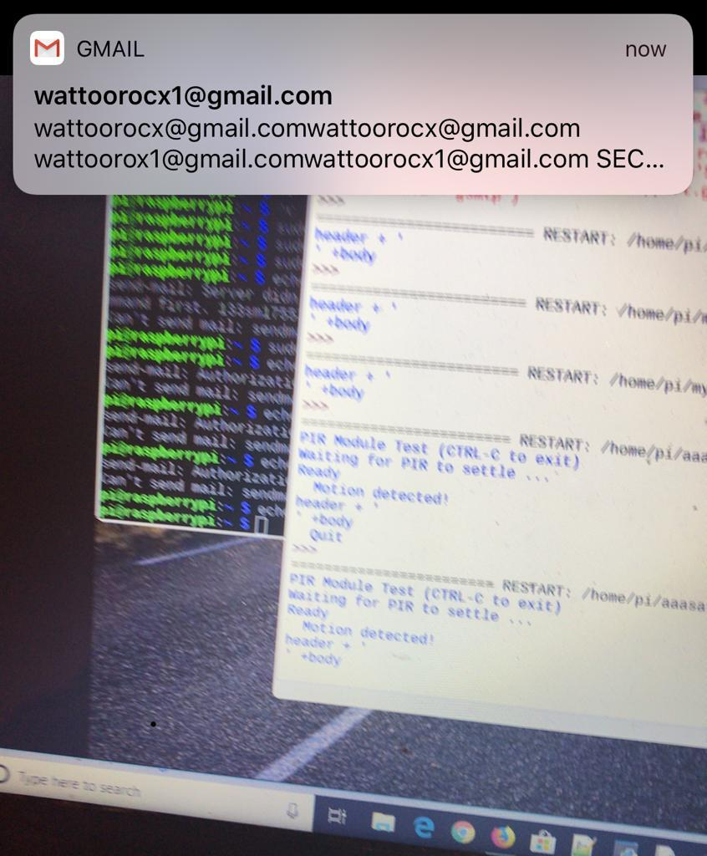
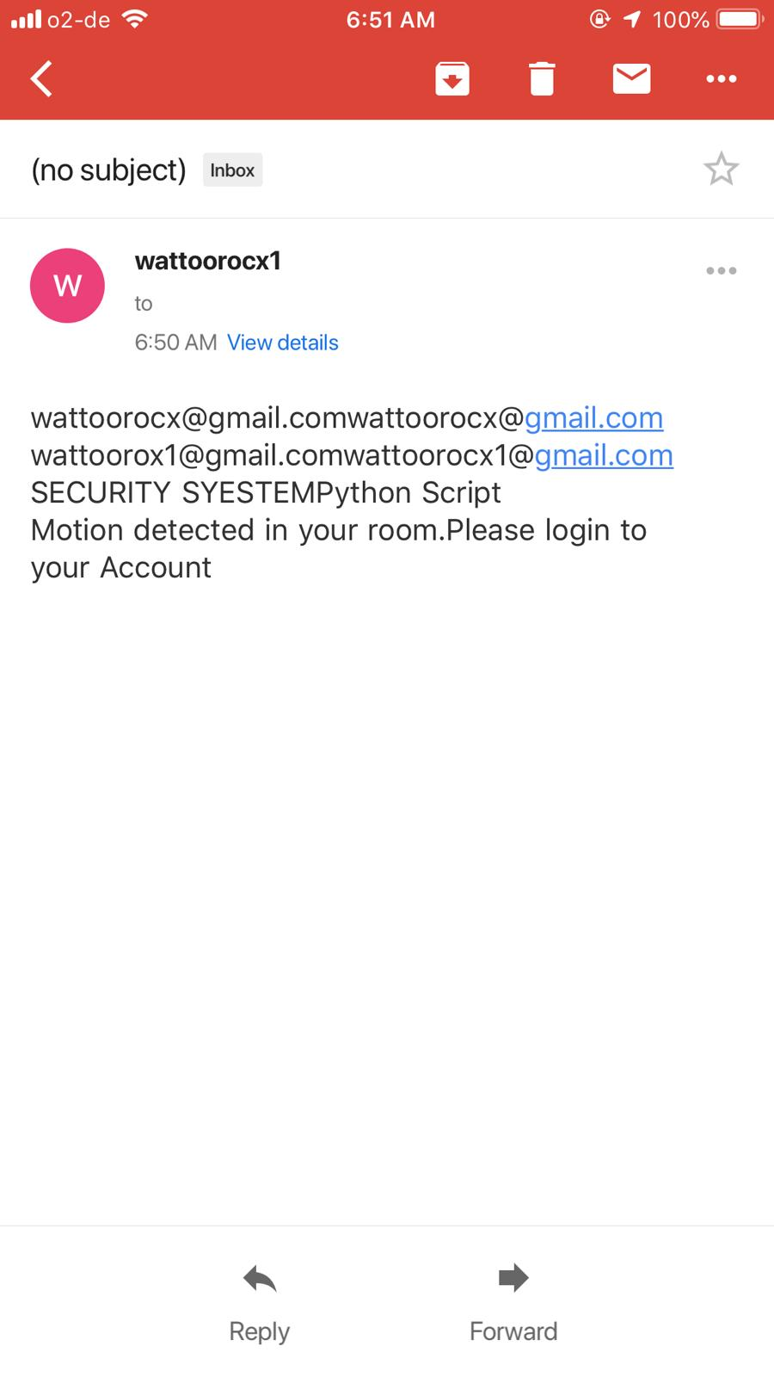
Workflow

Slide 12

Workflow

Slide 13

Workflow

Slide 14
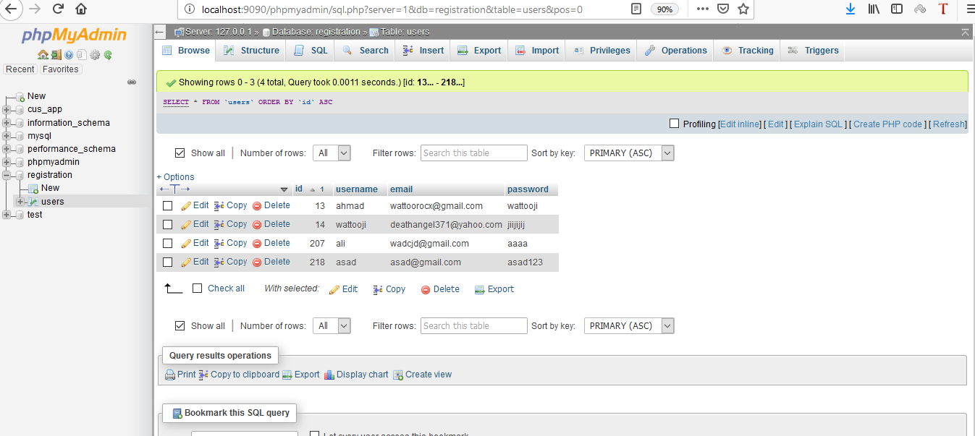
Workflow

Slide 15

Workflow

Slide 16
References
Research Article .https://pdfs.semanticscholar.org/157e/0e0cdf462c68df3307d75e4bd7505d71cab0.pdf
For detecting motion https://dataissexy.wordpress.com/2013/06/29/raspberry-pi-pir-motion-detection-and-alerting-to-sms-raspberrypi-sms-sensors/
Send email
https://www.youtube.com/watch?v=0kpGcMjpDcw&t=6s
Connect pi to php
https://www.youtube.com/watch?v=pMx0hVjAygo
16

Slide 17

END

